Slide 1



Arrays
Prof. Arpita Vaidya
Assistant Professor
Computer Science and Engineering

Slide 2
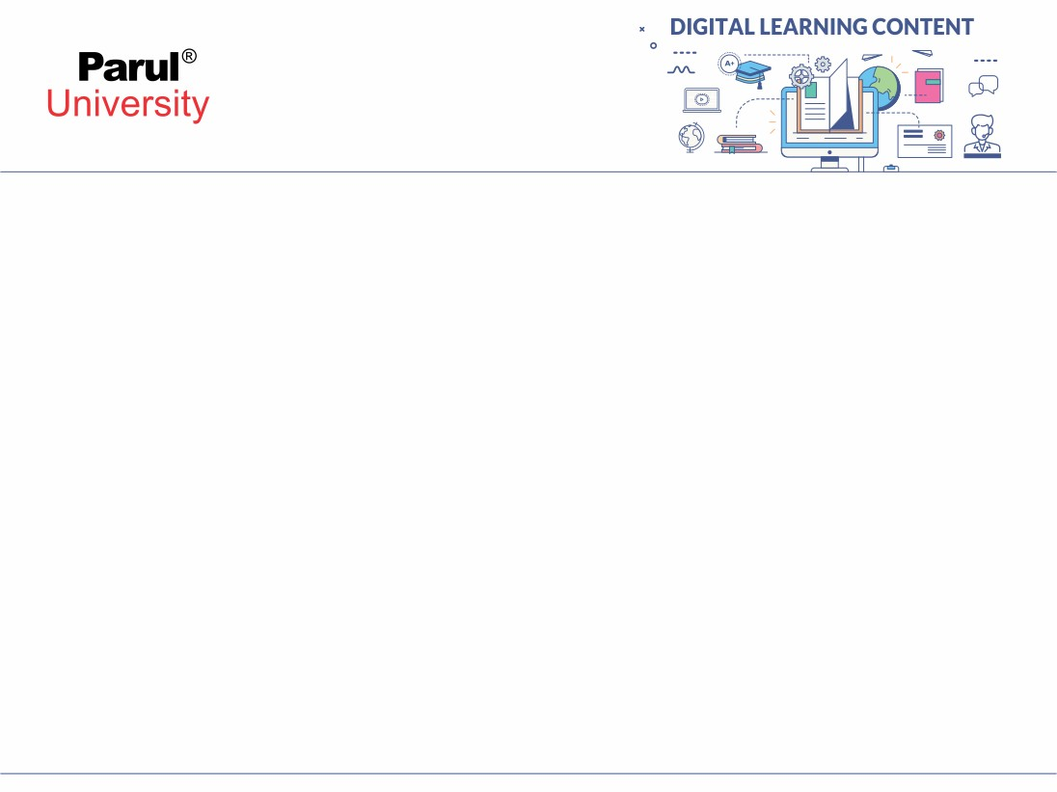

CHAPTER-1
Arrays

Slide 3
Outline
Introduction of Array
Pointer and Arrays
Array of Functions
String

Slide 4
Need of Array Variable
Suppose we need to store rollno of the student in the integer variable.
Now we need to store rollno of 100 students.
This is not appropriate to declare these many integer variables.
e.g. 100 integer variables for rollno.
Solution to declare and store multiple variables of similar type is an array.
An array is a variable that can store multiple values.
Declaration
int rollno;
Declaration
int rollno101, rollno102, rollno103, rollno104...;

Slide 5
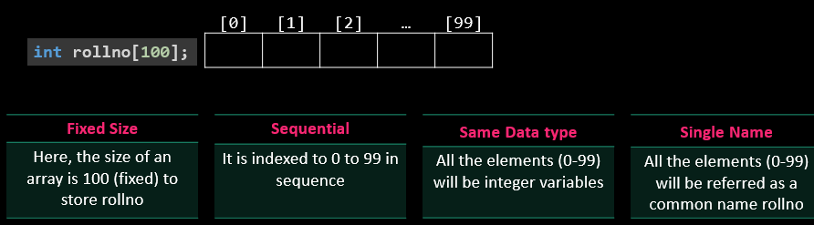
Definition: Array
An array is a fixed size sequential collection of elements of same data type grouped under single variable name.

Slide 6
Definition: Array
An array is defined as the collection of similar type of data items stored at contiguous memory locations. Arrays are the derived data type in C programming language which can store the primitive type of data such as int, char, double, float, etc.
It also has the capability to store the collection of derived data types, such as pointers, structure, etc.
The array is the simplest data structure where each data element can be randomly accessed by using its index number.

Slide 7
Advantage of C Array
Code Optimization: Less code to the access the data.
2) Ease of traversing: By using the for loop, we can retrieve the elements of an array easily.
3) Ease of sorting: To sort the elements of the array, we need a few lines of code only.
4) Random Access: We can access any element randomly using the array.

Slide 8
Disadvantage of C Array
Fixed Size: We define the size at the time of declaration of the array, we can't exceed the limit. So, it doesn't grow the size dynamically like LinkedList

Slide 9
Declaring an array
Syntax
By default array index starts with 0.
If we declare an array of size 5 then its index ranges from 0 to 4.
First element will be store at mark[0] and last element will be stored at mark[4] not mark[5].
Like integer and float array we can declare array of type char.
data-type variable-name[size];
Integer Array
[0] | [1] | [2] | [3] | [4]
int mark[5];
integer
[0] | [1] | [2] | [3] | [4]
Float Array
float avg[5];
float

Slide 10
Initialing and Accessing an Array
Declaring, initializing and accessing single integer variable
int mark=90; //variable mark is initialized with value 90
printf("%d",mark); //mark value printed
Declaring, initializing and accessing integer array variable
int mark[5]={85,75,76,55,45}; //mark is initialized with 5 values
printf("%d",mark[0]); //prints 85
printf("%d",mark[1]); //prints 75
printf("%d",mark[2]); //prints 65
printf("%d",mark[3]); //prints 55
printf("%d",mark[4]); //prints 45
[0] | [1] | [2] | [3] | [4]
85 | 75 | 65 | 55 | 45
mark[5]

Slide 11
Read(Scan) Array Elements
Reading array without loop
Reading array using loop
void main()
{
int mark[5];
printf("Enter array element=");
scanf("%d",&mark[0]);
printf("Enter array element=");
scanf("%d",&mark[1]);
printf("Enter array element=");
scanf("%d",&mark[2]);
printf("Enter array element=");
scanf("%d",&mark[3]);
printf("Enter array element=");
scanf("%d",&mark[4]); printf("%d",mark[0]);
printf("%d",mark[1]);
printf("%d",mark[2]);
printf("%d",mark[3]);
printf("%d",mark[4]); }
void main()
{
int mark[5],i;
for(i=0;i<5;i++)
{
printf("Enter array element=");
scanf("%d",&mark[i]);
}
for(i=0;i<5;i++)
{
printf("%d",mark[i]);
}
}
[0] | [1] | [2] | [3] | [4]
85 | 75 | 65 | 55 | 45
mark[5]

Slide 12
Develop a program to count number of positive or negative number from an array of 10 Number
Program
void main(){
int num[10],i,pos,neg;
pos = 0;
neg = 0;
for(i=0;i<10;i++)
{
printf("Enter array element=");
scanf("%d",&num[i]);
}
for(i=0;i<10;i++)
{
if(num[i]>0)
pos=pos+1;
else
neg=neg+1;
}
printf("Positive=%d,Negative=%d",pos,eg);}
Output
Enter array element=1
Enter array element=2
Enter array element=3
Enter array element=4
Enter array element=5
Enter array element=-1
Enter array element=-2
Enter array element=3
Enter array element=4
Enter array element=5
Positive=8,Negative=2

Slide 13

Two dimensional Array in C

Slide 14
Two dimensional Array in C
Syntax
data-type variable-name[x][y];
A two dimensional array can be seen as a table with ‘x’ rows and ‘y’ columns.
The row number ranges from 0 to (x-1) and column number ranges from 0 to (y-1).
Declaration
int data[3][3]; //This array can hold 9 elements
 | Column-0 | Column-1 | Column-2
Row-0 | data[0][0] | data[0][1] | data[0][2]
Row-1 | data[1][0] | data[1][1] | data[1][2]
Row-2 | data[2][0] | data[2][1] | data[2][2]
int data[3][3];

Slide 15
Initialing and Accessing a 2D Array: Example-1
Program
int data[3][3] = {
{1,2,3}, //row 0 with 3 elements
{4,5,6}, //row 1 with 3 elements
{7,8,9} //row 2 with 3 elements};
printf("%d",data[0][0]); //1
printf("%d",data[0][1]); //2
printf("%d\n",data[0][2]); //3
printf("%d",data[1][0]); //4
printf("%d",data[1][1]); //5
printf("%d\n",data[1][2]); //6
printf("%d",data[2][0]);//7
printf("%d",data[2][1]); //8
printf("%d",data[2][2]); //9
 | Column-0 | Column-1 | Column-2
Row-0 | 1 | 2 | 3
Row-1 | 4 | 5 | 6
Row-2 | 7 | 8 | 9
// data[3][3] can be initialized like this also
int data[3][3]={{1,2,3},{4,5,6},{7,8,9}};

Slide 16
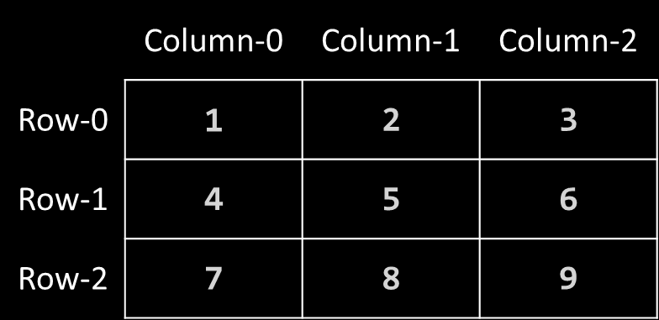
Read(Scan) 2D Array Elements
Program
void main(){
int data[3][3],i,j;
for(i=0;i<3;i++)
{
for(j=0;j<3;j++)
{
printf("Enter array element=");
scanf("%d",&data[i][j]);
}
}
for(i=0;i<3;i++)
{
for(j=0;j<3;j++)
{
printf("%d",data[i][j]);
}
printf("\n"); }}
Output
Enter array element=1
Enter array element=2
Enter array element=3
Enter array element=4
Enter array element=5
Enter array element=6
Enter array element=7
Enter array element=8
Enter array element=9
1 2 3
4 5 6
7 8 9

Slide 17
Develop a program to count number of positive, negative and zero elements from 3 X 3 matrix
Program
Output
void main(){
int data[3][3],i,j,pos=0,neg=0,zero=0;
for(i=0;i<3;i++)
{
for(j=0;j<3;j++)
{
printf("Enter array element=");
scanf("%d",&data[i][j]);
if(data[i][j]>0)
pos=pos+1;
else if(data[i][j]<0)
neg=neg+1;
else
zero=zero+1;
}
}
printf("positive=%d,negative=%d,zero=%d",pos,neg,zero)}
Enter array element=9
Enter array element=5
Enter array element=6
Enter array element=-3
Enter array element=-7
Enter array element=0
Enter array element=11
Enter array element=13
Enter array element=8
positive=6,negative=2,zero=1

Slide 18
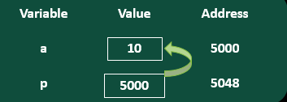
Declaration & Initialization of Pointer
Syntax
p is integer pointer variable
& is address of or referencing operator which returns memory address of variable.
* is indirection or dereferencing operator which returns value stored at that memory address.
& operator is the inverse of * operator
x = a is same as x = *(&a)
datatype *ptr_variablename;
Example
void main()
{
int a=10, *p; // assign memory address of a to pointer variable p
p = &a;
printf("%d %d %d", a, *p, p);
}
Output
10 10 5000

Slide 19
Write a program to print variable, address of pointer variable and pointer to pointer variable.
C uses pointers to create dynamic data structures, data structures built up from blocks of memory allocated from the heap at run-time. Example linked list, tree, etc.
C uses pointers to handle variable parameters passed to functions.
Pointers in C provide an alternative way to access information stored in arrays.
Pointer use in system level programming where memory addresses are useful. For example shared memory used by multiple threads.
Pointers are used for file handling.
This is the reason why C is versatile.

Slide 20
Why use Pointer?
C uses pointers to create dynamic data structures, data structures built up from blocks of memory allocated from the heap at run-time. Example linked list, tree, etc.
C uses pointers to handle variable parameters passed to functions.
Pointers in C provide an alternative way to access information stored in arrays.
Pointer use in system level programming where memory addresses are useful. For example shared memory used by multiple threads.
Pointers are used for file handling.
This is the reason why C is versatile.

Slide 21
Pointer to Pointer – Double Pointer
Pointer holds the address of another variable of same type.
When a pointer holds the address of another pointer then such type of pointer is known as pointer-to-pointer or double pointer.
The first pointer contains the address of the second pointer, which points to the location that contains the actual value.
Syntax
Pointer
Pointer
Variable
datatype **ptr_variablename;
int **ptr;
address
address
value

Slide 22
Write a program to print variable, address of pointer variable and pointer to pointer variable.
#include <stdio.h>
int main () {
int var;
int *ptr;
int **pptr;
var = 3000;
ptr = &var; // address of var
pptr = &ptr; // address of ptr using address of operator &
printf("Value of var = %d\n", var );
printf("Value available at *ptr = %d\n", *ptr );
printf("Value available at **pptr = %d\n", **pptr);
return 0;
}
Output
Value of var = 3000
Value available at *ptr = 3000
Value available at **pptr = 3000

Slide 23
Relation between Array & Pointer
When we declare an array, compiler allocates continuous blocks of memory so that all the elements of an array can be stored in that memory.
The address of first allocated byte or the address of first element is assigned to an array name.
Thus array name works as pointer variable.
The address of first element is also known as base address.
2018

Slide 24
Relation between Array & Pointer – Cont.
Example: int a[10], *p;
a[0] is same as *(a+0), a[2] is same as *(a+2) and a[i] is same as *(a+i)
a:
a[0]
a:
*(a+0)
2000
a[1]
a+1:
*(a+1)
2002
.
.
.
.
.
.
.
.
a:
a[i]
a+i:
*(a+i)
2000 + i*2
.
.
.
.
.
.
.
.
a[9]
a+9:
*(a+9)
2018

Slide 25
Array of Pointer
As we have an array of char, int, float etc, same way we can have an array of pointer.
Individual elements of an array will store the address values.
So, an array is a collection of values of similar type. It can also be a collection of references of similar type known by single name
Syntax
datatype *name[size];
2018
int *ptr[5]; //declares an array of integer pointer of size 5

Slide 26
Relation between Array & Pointer
When we declare an array, compiler allocates continuous blocks of memory so that all the elements of an array can be stored in that memory.
The address of first allocated byte or the address of first element is assigned to an array name.
Thus array name works as pointer variable.
The address of first element is also known as base address.
2018

Slide 27
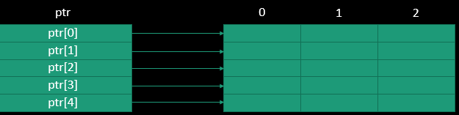
Array of Pointer – Cont.
An array of pointers ptr can be used to point to different rows of matrix as follow:
for(i=0; i<5; i++)
{
ptr[i]=&mat[i][0];
}
By dynamic memory allocation, we do not require to declare two-dimensional array, it can be created dynamically using array of pointers
2018

Slide 28
Write a program to swap value of two variables using pointer / call by reference
int main()
{
int num1,num2;
printf("Enter value of num1 and num2: ");
scanf("%d %d",&num1, &num2);
//displaying numbers before swapping
printf("Before Swapping: num1 is: %d, num2 is: %d\n",num1,num2);
//calling the user defined function swap()
swap(&num1,&num2);
//displaying numbers after swapping
printf("After Swapping: num1 is: %d, num2 is: %d\n",num1,num2);
return 0;
}
Output
Enter value of num1 and num2: 5
10
Before Swapping: num1 is: 5, num2 is: 10
After Swapping: num1 is: 10, num2 is: 5

Slide 29
String
The string can be defined as the one-dimensional array of characters terminated by a null ('\0').
The character array or the string is used to manipulate text such as word or sentences.
Each character in the array occupies one byte of memory, and the last character must always be 0.
The termination character ('\0') is important in a string since it is the only way to identify where the string ends.
char name[10];
[0] | [1] | [2] | … | [9]
[0] | [1] | [2] | [3] | [4] | [5] | [6] | [7] | [8] | [9]
C | O | M | P | U | T | E | R | \0
name[10]

Slide 30
String declaration and initialization
There are two ways to declare a string in c language.
By char array
By string literal
Initialization method 1:
char name[10]={‘C',‘O',‘M',‘P',‘U',‘T',‘E',’R’,'\0'};
Initialization method 2:
Declaration
char name[10]=“COMPUTER";
//'\0' will be automatically inserted at the end in this type of declaration.
char name[10];
[0] | [1] | [2] | [3] | [4] | [5] | [6] | [7] | [8] | [9]
C | O | M | P | U | T | E | R | \0
name[10]

Slide 31
Difference between char array and string literal
There are two main differences between char array and literal.
We need to add the null character '\0' at the end of the array by ourself whereas, it is appended internally by the compiler in the case of the character array.
The string literal cannot be reassigned to another set of characters whereas, we can reassign the characters of the array.

Slide 32
Read String: scanf()
void main()
{
char name[10];
printf("Enter name:");
scanf("%s",name);
printf("Name=%s",name);
}
Output
Enter name: Parul
Name=Parul
Output
Enter name: CSE Parul
Name=CSE
There is no need to use address of (&) operator in scanf to store a string.
As string name is an array of characters and the name of the array, i.e., name indicates the base address of the string (character array).
scanf() terminates its input on the first whitespace(space, tab, newline etc.) encountered.

Slide 33
Read String: gets()
#include<stdio.h>
void main()
{
char name[10];
printf("Enter name:");
gets(name); //read string including white spaces
printf("Name=%s",name);
}
Output
Enter name:Parul University Name=Parul University
gets(): Reads characters from the standard input and stores them as a string.
puts(): Prints characters from the standard.
scanf(): Reads input until it encounters whitespace, newline or End Of File(EOF) whereas gets() reads input until it encounters newline or End Of File(EOF).
gets(): Does not stop reading input when it encounters whitespace instead it takes whitespace as a string.

Slide 34
String Handling Functions : strlen()
C has several inbuilt functions to operate on string. These functions are known as string handling functions.
strlen(s1): returns length of a string in integer
Program
#include <stdio.h>
#include <string.h> //header file for string functions
void main()
{
char s1[10];
printf("Enter string:");
gets(s1);
printf("%d",strlen(s1)); // returns length of s1 in integer
}
Output
Enter string: Parul University
15

Slide 35
String Handling Functions: strcmp()
strcmp(s1,s2): Returns 0 if s1 and s2 are the same.
Returns less than 0 if s1<s2.
Returns greater than 0 if s1>s2.
Program
void main()
{
char s1[10],s2[10];
printf("Enter string-1:");
gets(s1);
printf("Enter string-2:");
gets(s2);
if(strcmp(s1,s2)==0)
printf("Strings are same");
else
printf("Strings are not same");}
Output
Enter string-1:Computer
Enter string-2:Computer
Strings are same
Output
Enter string-1:Computer
Enter string-2:Computer
Strings are same

Slide 36
String Handling Functions
For examples consider: char s1[]="Their",s2[]="There";
Syntax | Description
strstr(s1,s2) | Returns a pointer to the first occurrence of a given string s2 in string s1. printf("%s",strstr(s1,"he")); Output : heir
strcat(s1,s2) | Appends 2nd string at the end of 1st string. strcat(s1,s2); a copy of string s2 is appended at the end of string s1. Now s1 becomes “TheirThere”
strchr(s1,c) | Returns a pointer to the first occurrence of a given character in the string s1. printf("%s",strchr(s1,'i')); Output : ir
strcpy(s1,s2) | Copies 2nd string to 1st string. strcpy(s1,s2) copies the string s2 in to string s1 so s1 is now “There”. s2 remains unchanged.

Slide 37
For examples consider: char s1[]="Their",s2[]="There";
Syntax | Description
strrev(s1) | Reverses given string. strrev(s1); makes string s1 to “riehT”
strlwr(s1) | Converts string s1 to lower case. printf("%s",strlwr(s1)); Output : their
strncpy(s1,s2,n) | Copies first n character of string s2 to string s1 s1=""; s2="There"; strncpy(s1,s2,2); printf("%s",s1); Output : Th
strncat(s1,s2,n) | Appends first n character of string s2 at the end of string s1. strncat(s1,s2,2); printf("%s", s1); Output : TheirTh

Slide 38
For examples consider: char s1[]="Their",s2[]="There";
ntax | Description
strncmp(s1,s2,n) | Compares first n character of string s1 and s2 and returns similar result as strcmp() function. printf("%d",strcmp(s1,s2,3)); Output : 0
strrchr(s1,c) | Returns the last occurrence of a given character in a string s1. printf("%s",strrchr(s2,'e')); Output : ere

Slide 39
An Array of Strings in C
An Array is the simplest Data Structure in C that stores homogeneous data in contiguous memory locations.
#include<stdio.h>
int main()
{
int i, arr[5] = {1, 2, 4, 2, 4};
for(i = 0; i < 5; i++)
{
printf("%d ", arr[i]);
}
}
Output :
1 2 4 2 4

Slide 40
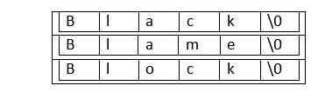
Conti..
An Array of Strings which means we are trying to create an Array of Character Arrays. We have two ways we can do this:
1)Using Two-dimensional Arrays
2)Using Pointers
Using Two-dimensional Arrays:
Creating a String Array is one of the applications of two-dimensional Arrays.
For suppose we want to create an Array of 3 Strings of size 5:
Syntax to create a 2D Array:
Data_type name[rows][columns] = {{values in row 1}, {values in row 2}…};

Slide 41
Declaration and Example
char Array[rows][columns] = {"String1", "String2"...};
#include<stdio.h>
int main()
{
char Array[3][6] = {"Black", "Blame", "Block"};
printf("String Array: \n");
int i;
for(i = 0; i < 3; i++)
{
printf("%s\n", Array[i]);
}
return 0;
}
Output :
String Array:
Black
Blame
Block

Slide 42
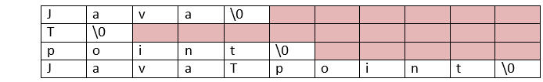
Disadvantage of using 2D Arrays
The number of rows will be equal to the number of Strings, but the number of columns will equal the length of the longest String.
The orange part in the above representation is the memory wasted.
The memory allocated to all the Strings will be the size of the longest String, causing "Memory wastage".

Slide 43
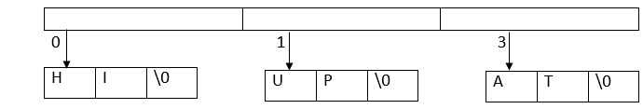
Using Pointer in String Array
Syntax to create an Array of Pointers:
Data Type* name[] = {"Value 1", "Value 2"…};
Syntax to create an Array of String Pointers:
char* Array[] = {"String 1", "String 2"…};

Slide 44
Continue…
#include<stdio.h>
#include<string.h>
int main()
{
int i;
char* Array[] = {"HI", "UP", "AT"};
printf("String Array:\n");
for(i = 0; i < 3; i++)
{
printf("%s\n", Array[i]);
}
return 0;
}
Output :
String Array:
HI
UP
AT

Slide 45
Difference between 2-D Array and Using Pointer in string
1. Using a Two-Dimensional Array:
The Disadvantage of using this way is "Memory wastage," as the memory allocated to every String in the Array will be the memory required to store the longest String of the Array.
2. Using Pointers:
Using Pointers, we create a single-dimensional Array of Pointers pointing to Strings. Following this method can eliminate the "Memory wastage" Disadvantage.

Slide 46

www.paruluniversity.ac.in

